Slide 1
Building Generative Adversarial Networks
Project Purposes:
Develop group members’ knowledge of neural networks and AI concepts
Design a reliable and practical image generator
Goal Statement:
Develop a functional generative adversarial network, capable of producing convincing images of real-life phenomena.

Slide 2
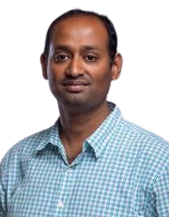
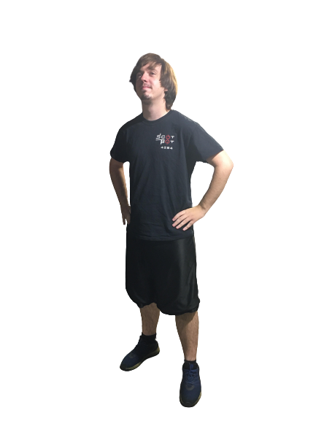
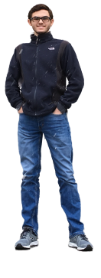
Team: ShenaniGANs
Dr. Badri Vellambi
vellambn@ucmail.uc.edu
Project Advisor
Tim Neale
nealetw@mail.uc.edu
Daniel Hackney
hacknedn@mail.uc.edu

Slide 3
Abstract
Our project will utilize neural networks to produce data that can reliably trick a human into thinking the data is real rather than artificially generated. After setting up a generator and discriminator model, we will be able to provide a collection of existing image and begin training them. The generator will seek out patterns to generate original images, while the discriminator will train to get better at determining whether the images it receives are real or fake. Ultimately, they will improve each other in an adversarial "zero-sum game." Depending on the application, this kind of deep learning can be used to provide unique and realistic images, videos, text, and other types of data to users.

Slide 4
User Stories
As an artist, I want zoological subjects to use as inspiration for paintings and sculptures.
As a computer scientist, I want to demonstrate the capabilities of GANs for non-technical audiences to appreciate and remember.
As a dungeon master, I want to find new and unique creatures so that my Dungeons & Dragons campaign is more interesting.

Slide 5
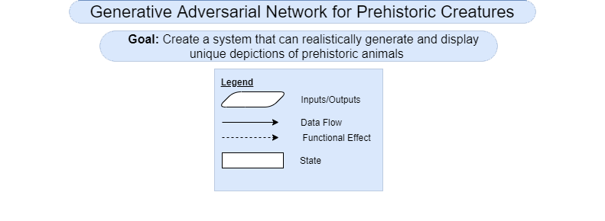
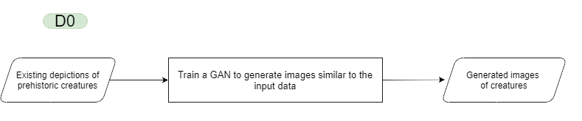
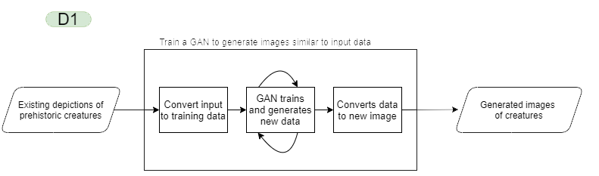
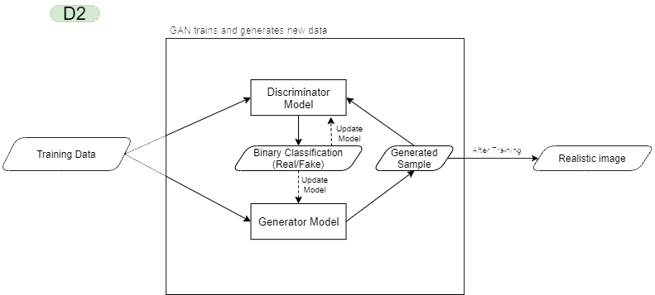
Design Diagrams

Slide 6
Project Constraints
Computing Resources
With how computationally complex neural networks are, our group is not sure whether the computers currently available to us will be able to handle our project. This constraint may lower our possible outcomes and deliverables depending on what resources we can attain. The threshold of acceptability may need to be lowered to accommodate the lack of resources in this area.
Technical Knowledge
Given that our experience with neural networks, machine learning, and GANs are extremely limited as of the start of this project, the proficiency of our work may be adversely affected. A large amount of time will need to be dedicated towards increasing our theoretical understanding of GANs and practical usage of the software platforms used to develop and train them. Additional time may be required to learn the programming language we choose to use, as well as the appropriate software libraries for it.
Project Scope
With how varied the individual components to our project are, our group members may need to spend a longer amount of time researching and tweaking them to work properly. To ensure our group does not overstate a realistic scope, we will most likely be considering an underestimated scope at the beginning of our project. Once further research and development has been done, the scope may be modified to reflect how the final deliverables of the project could look like.

Slide 7
Current Project Progress
Research has been conducted on the high level components and structure of GANs
Project scope has been thoroughly considered, and brainstorming for possible GANs has been done

Slide 8
Accomplishments for End of Term
Prep for code generation, choose ideal language
Code for a smaller GAN with a relaxed scope (proof of concept)
Research image processing
Research Neural Networks
Research resources to train GANs effectively

Slide 9
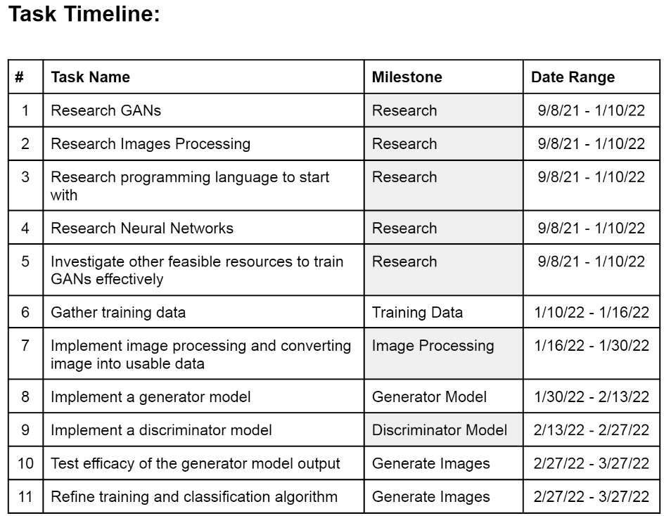
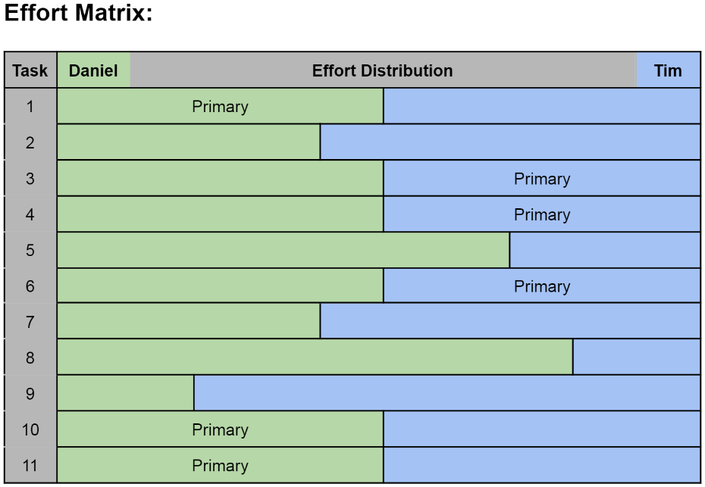
Division of Work

Slide 10
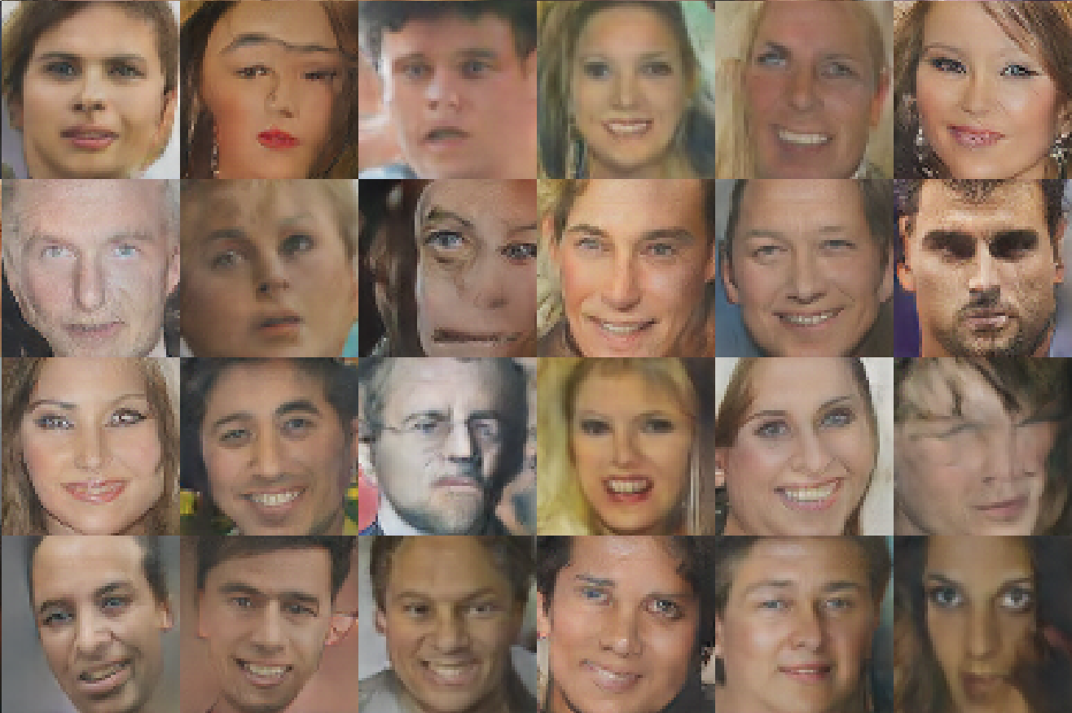
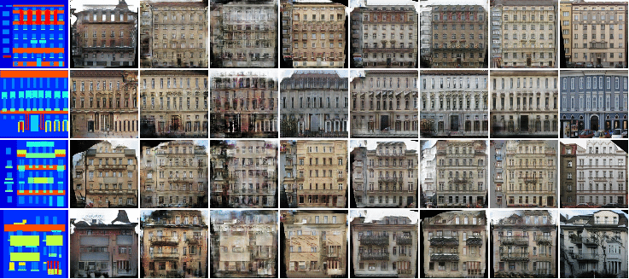
Expected Demo at Expo
Poster with GAN-generated images, inviting viewers to guess which are real or fake.
Information about what GANs are, how they work, and where they can be applied
Demonstration of image generation using GANs on a laptop

